Slide 1
DISTRIBUTED SYSTEMS Principles and Paradigms Second Edition ANDREW S. TANENBAUM MAARTEN VAN STEEN Chapter 1 Introduction

Slide 2
Definition of a Distributed System (1)
A distributed system is:
A collection of independent computers that appears to its users as a single coherent system.

Slide 3
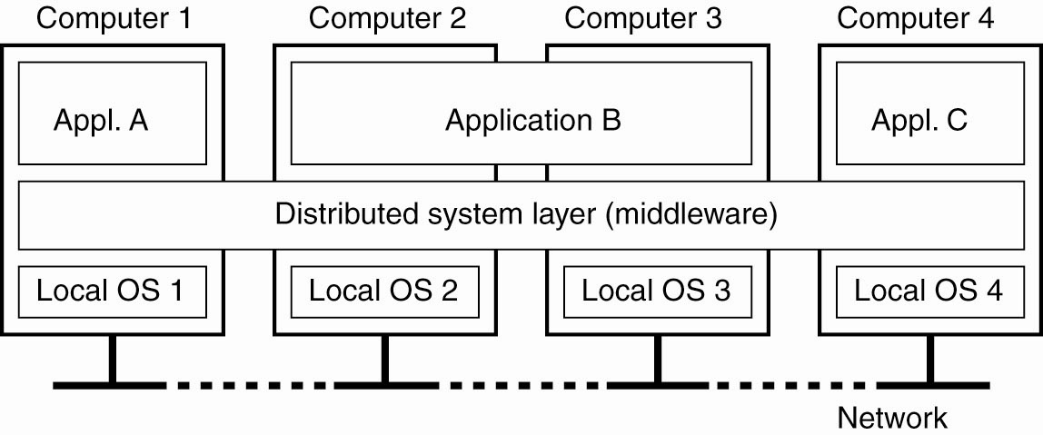
Definition of a Distributed System (2)
Figure 1-1. A distributed system organized as middleware. The middleware layer extends over multiple machines, and offers each application the same interface.

Slide 4
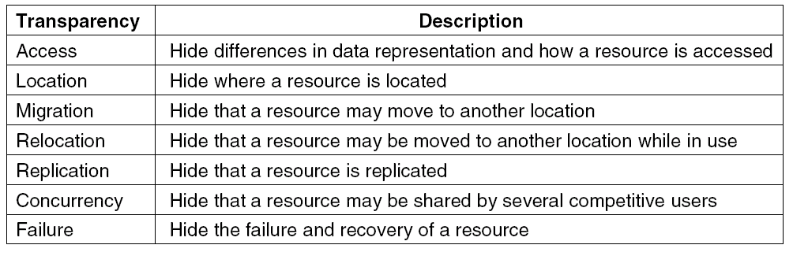
Transparency in a Distributed System
Figure 1-2. Different forms of transparency in a distributed system (ISO, 1995).

Slide 5
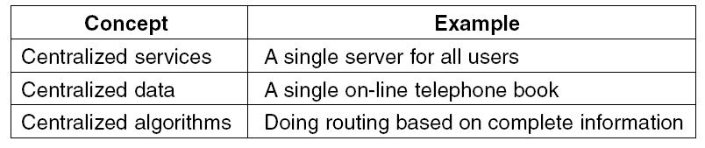
Scalability Problems
Figure 1-3. Examples of scalability limitations.

Slide 6
Scalability Problems
Characteristics of decentralized algorithms:
No machine has complete information about the system state.
Machines make decisions based only on local information.
Failure of one machine does not ruin the algorithm.
There is no implicit assumption that a global clock exists.

Slide 7
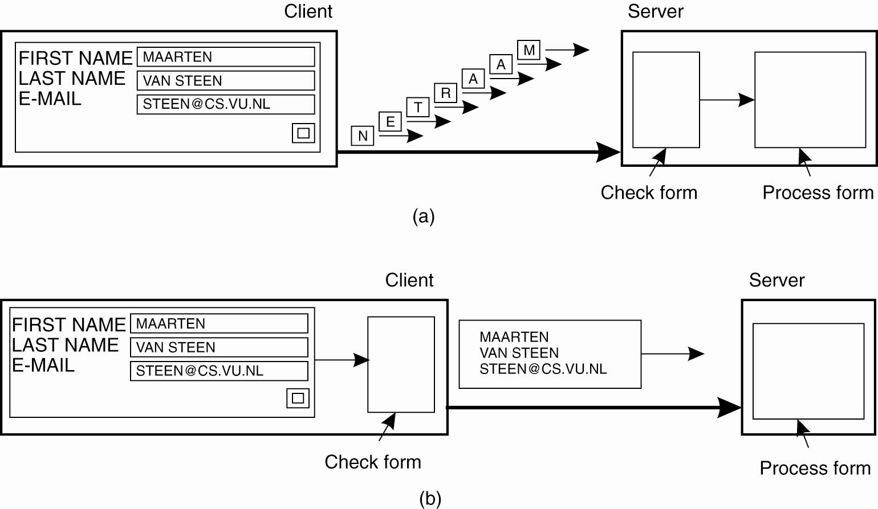
Scaling Techniques (1)
Figure 1-4. The difference between letting (a) a server or (b) a client check forms as they are being filled.

Slide 8
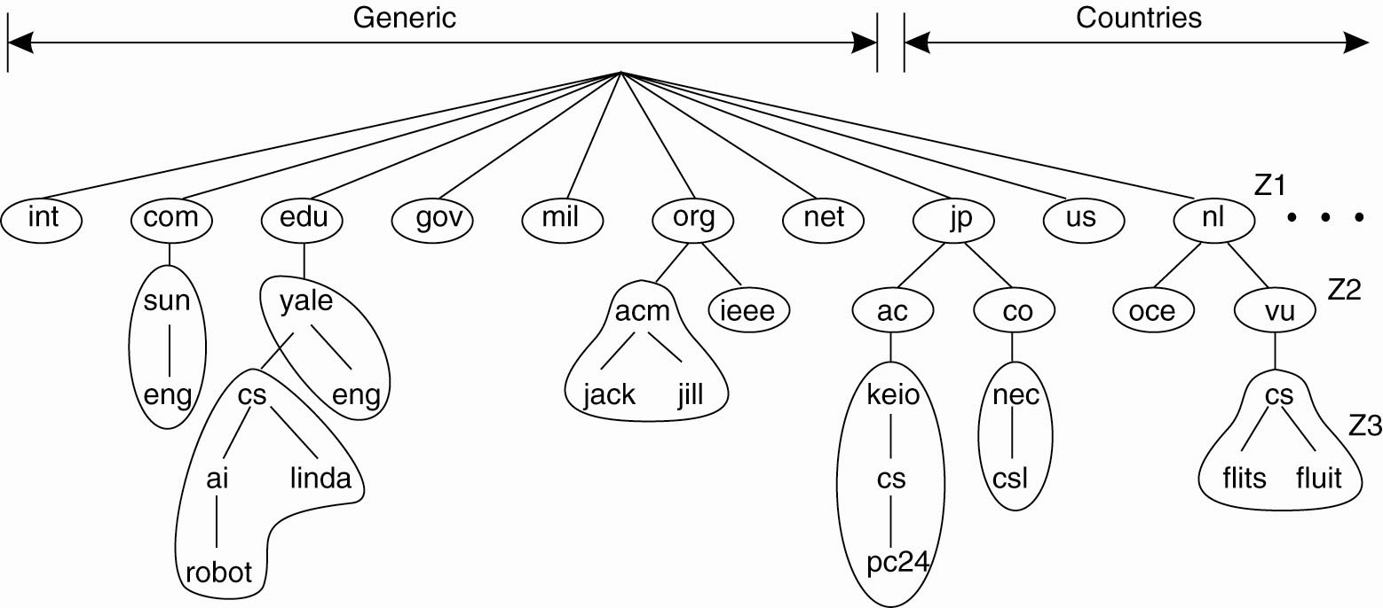
Scaling Techniques (2)
Figure 1-5. An example of dividing the DNS name space into zones.

Slide 9
Pitfalls when Developing Distributed Systems
False assumptions made by first time developer:
The network is reliable.
The network is secure.
The network is homogeneous.
The topology does not change.
Latency is zero.
Bandwidth is infinite.
Transport cost is zero.
There is one administrator.

Slide 10
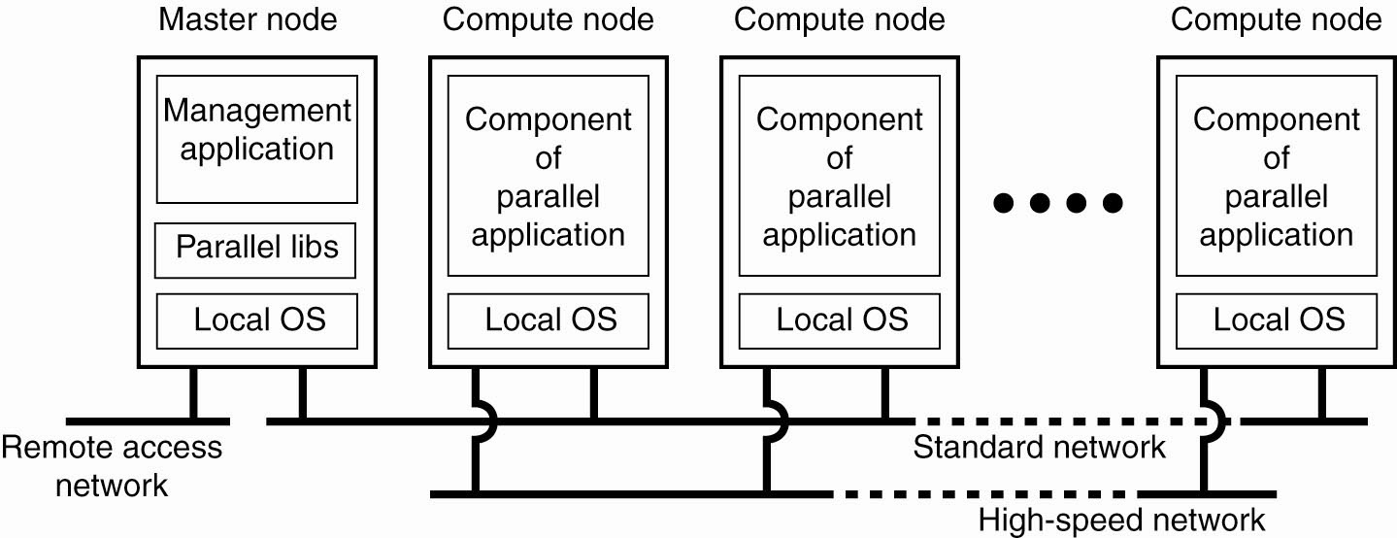
Cluster Computing Systems
Figure 1-6. An example of a cluster computing system.

Slide 11
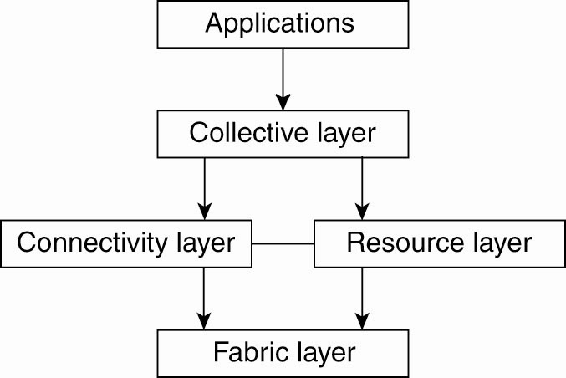
Grid Computing Systems
Figure 1-7. A layered architecture for grid computing systems.

Slide 12
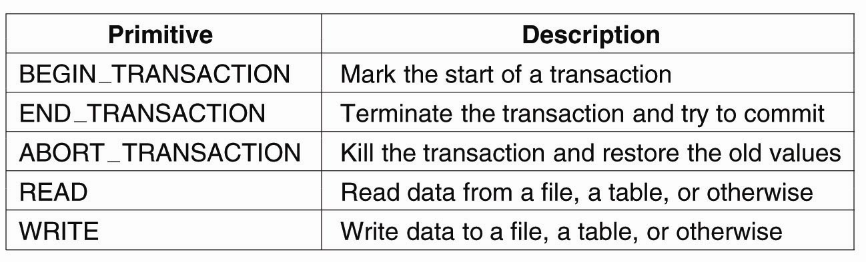
Transaction Processing Systems (1)
Figure 1-8. Example primitives for transactions.

Slide 13
Transaction Processing Systems (2)
Characteristic properties of transactions:
Atomic: To the outside world, the transaction happens indivisibly.
Consistent: The transaction does not violate system invariants.
Isolated: Concurrent transactions do not interfere with each other.
Durable: Once a transaction commits, the changes are permanent.

Slide 14
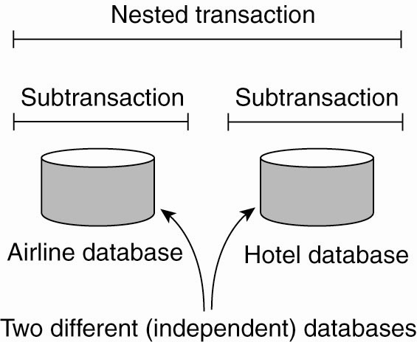
Transaction Processing Systems (3)
Figure 1-9. A nested transaction.

Slide 15
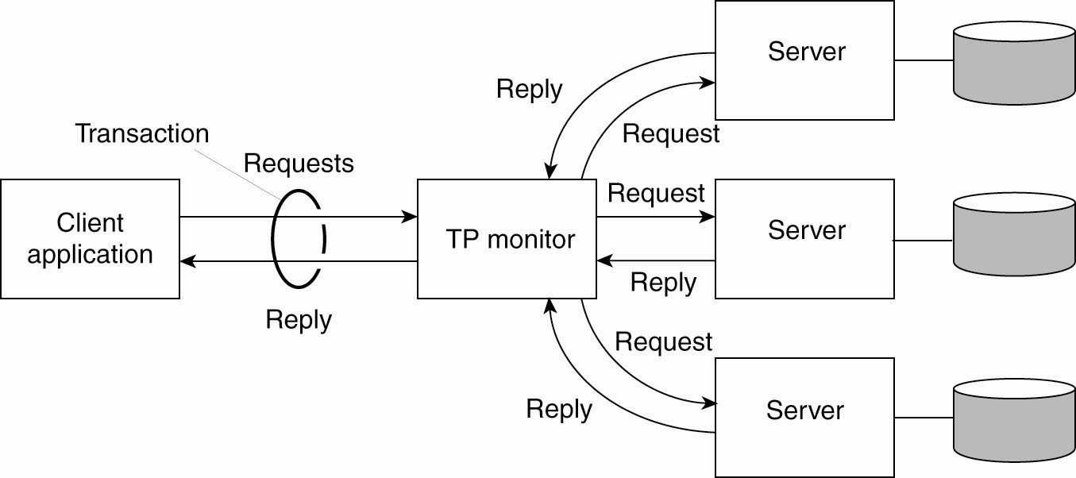
Transaction Processing Systems (4)
Figure 1-10. The role of a TP monitor in distributed systems.

Slide 16
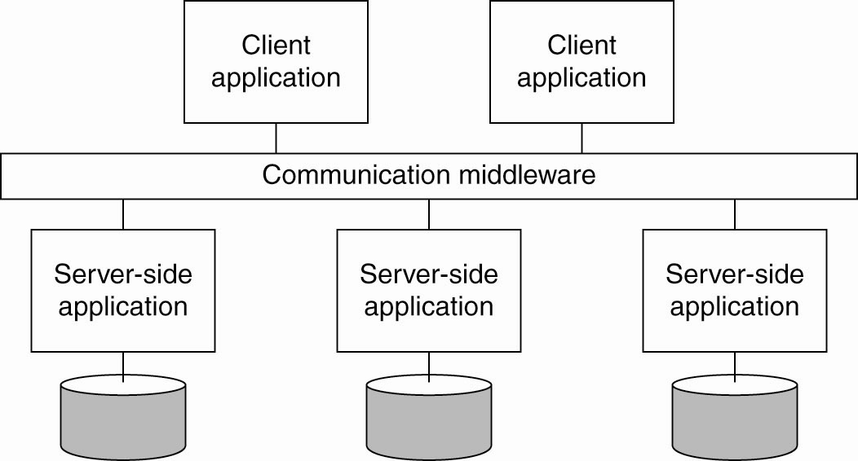
Enterprise Application Integration
Figure 1-11. Middleware as a communication facilitator in enterprise application integration.

Slide 17
Sensor Networks (1)
Questions concerning sensor networks:
How do we (dynamically) set up an efficient tree in a sensor network?
How does aggregation of results take place? Can it be controlled?
What happens when network links fail?

Slide 18
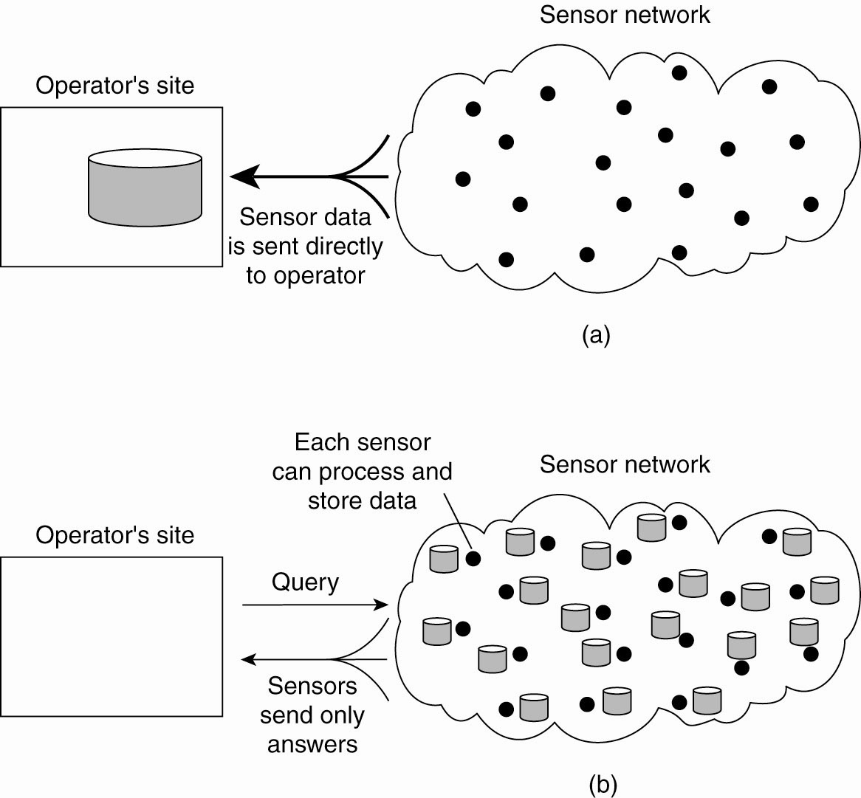
Sensor Networks (2)
Figure 1-13. Organizing a sensor network database, while storing and processing data (a) only at the operator’s site or …

Slide 19
Sensor Networks (3)
Figure 1-13. Organizing a sensor network database, while storing and processing data … or (b) only at the sensors.

